Slide 1
The Art of George Rodrigue: Blue Dogs 1984-2010

Slide 2
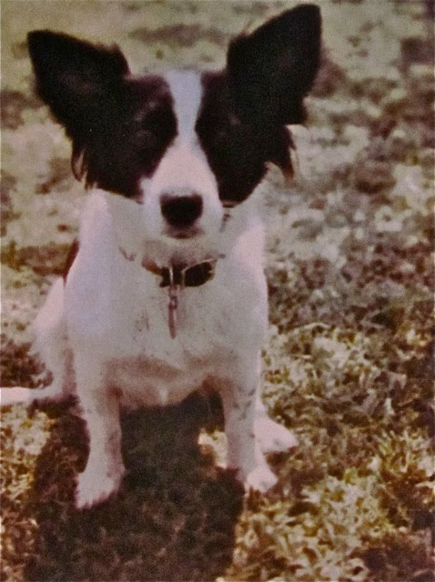
Tiffany, George’s terrier-spaniel, 1980

Slide 3
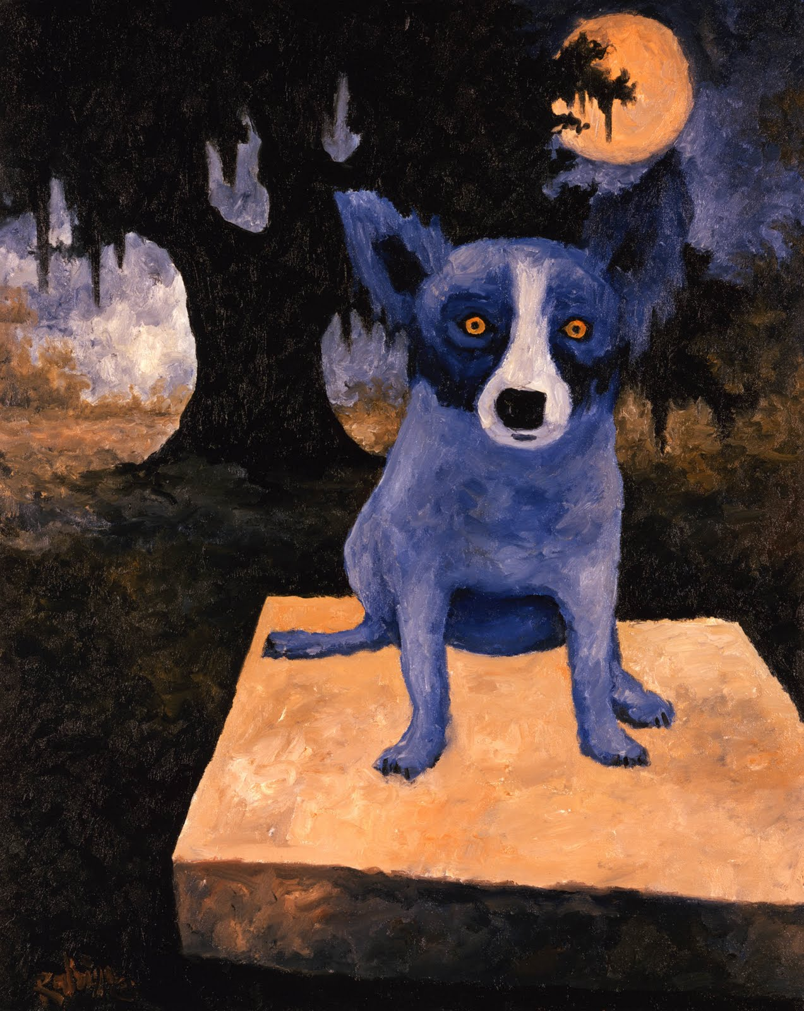
Midnight Moon, 30x24 inches, oil on canvas, 1990

Slide 4
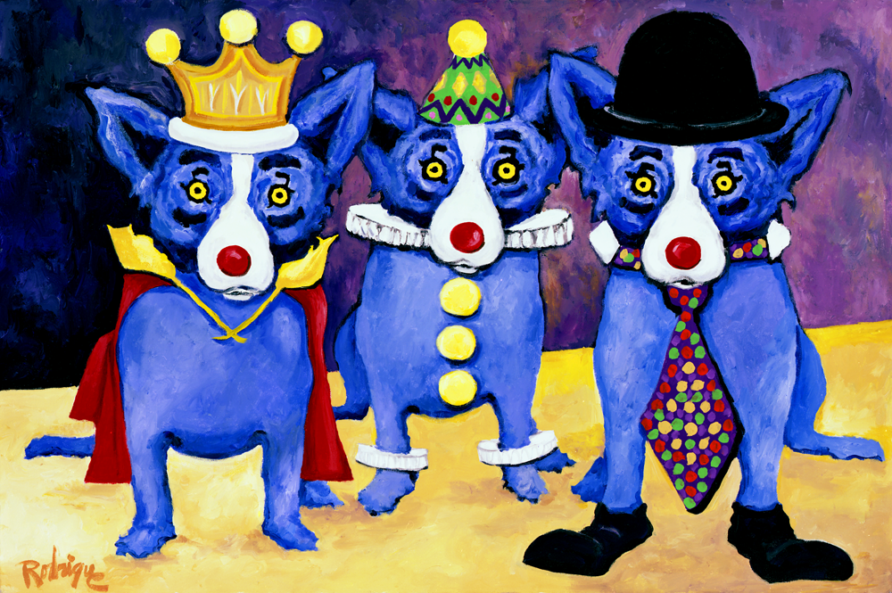
I Just Don’t Wanna Be Me, 24x36 inches, oil on canvas, 1991

Slide 5
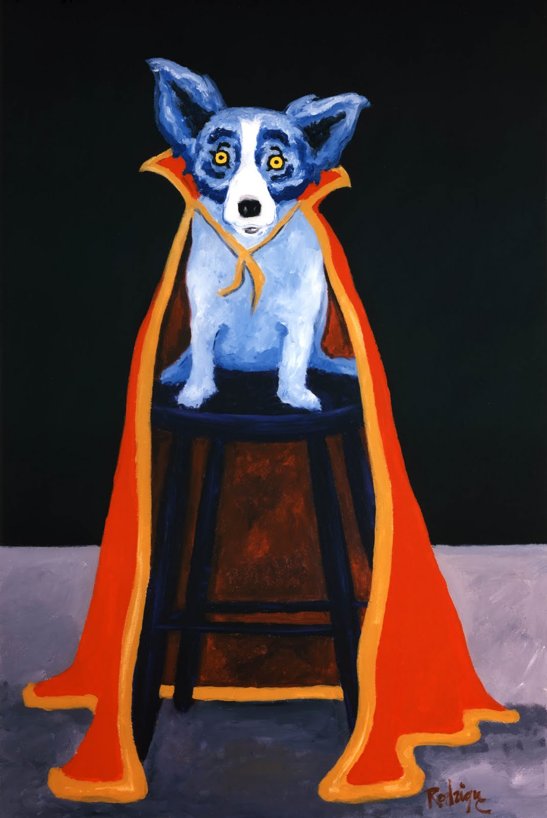
I Was A King in High Places, 36x24 inches, oil on canvas, 1992

Slide 6
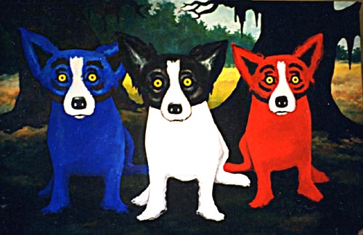
Me, Myself, & I in Louisiana, 96x180, acrylic on canvas, 1995

Slide 7
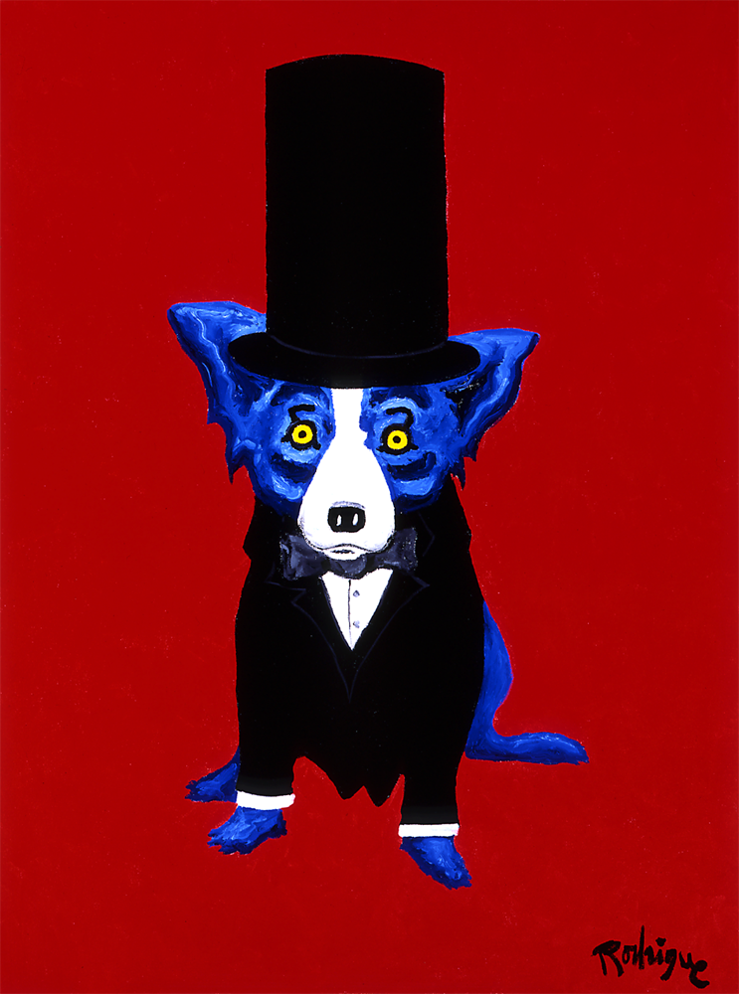
As Honest as the Day is Long, 40x30 inches, acrylic on canvas, 1996

Slide 8
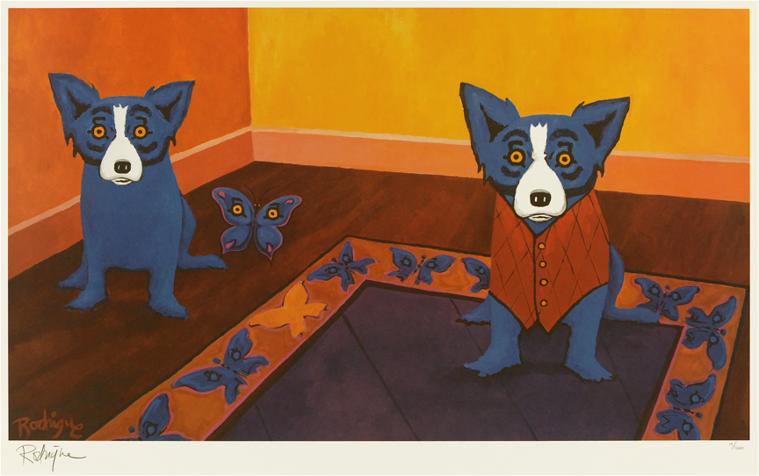
Butterflies Are Free, 36x63 inches, acrylic on canvas, 1996

Slide 9
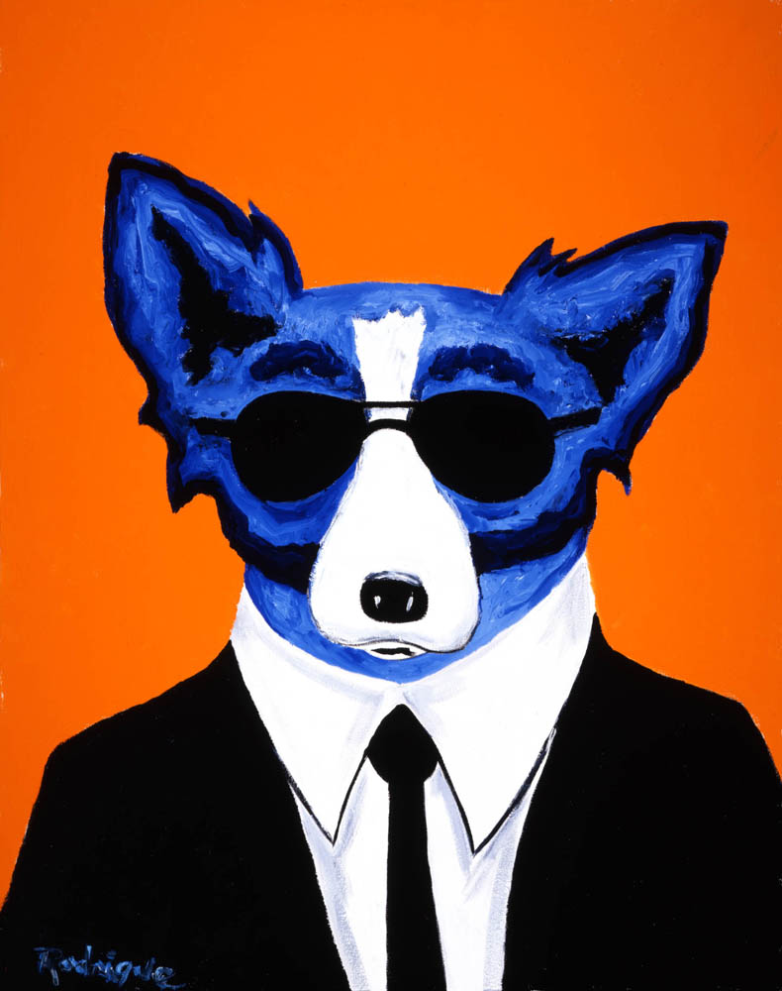
Secret Service Dog, 30x24 inches, acrylic on canvas, 1996

Slide 10
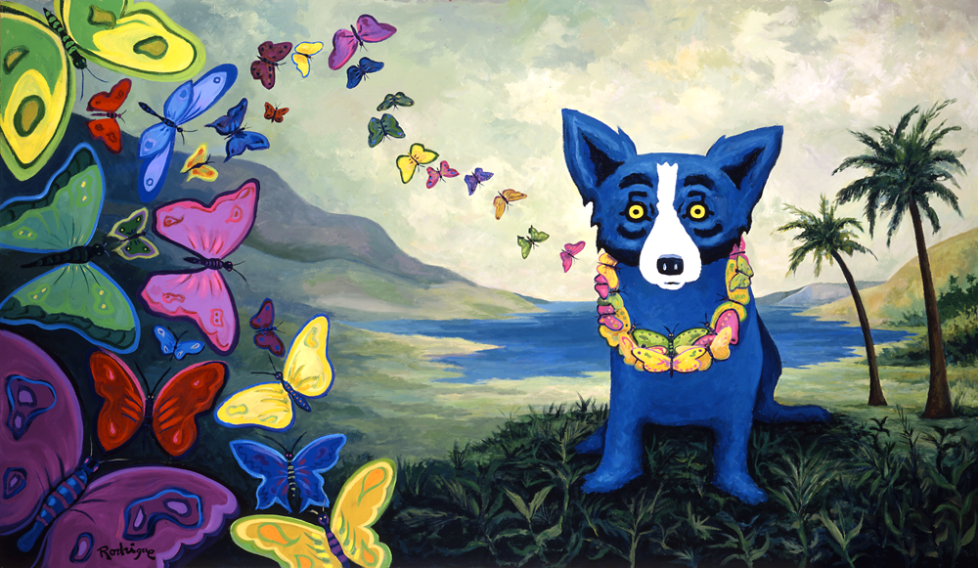
Hawaiian Blues, 36x63 inches, acrylic on canvas, 1998

Slide 11
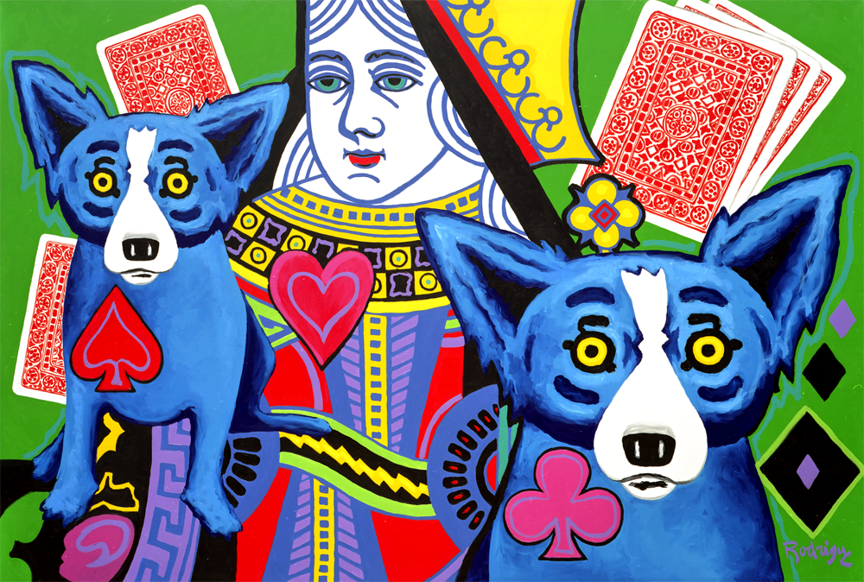
Luck Be a Lady, 72x96 inches, acrylic on canvas, 1999

Slide 12
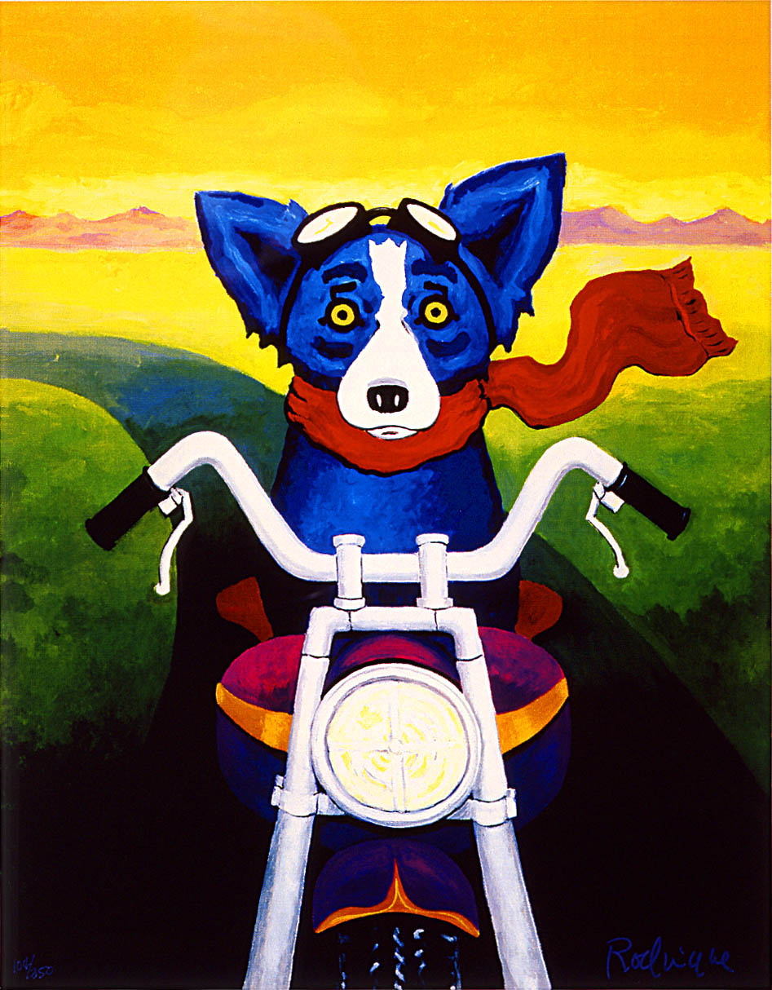
A Faster Breed, 48x36 inches, acrylic on canvas, 2000

Slide 13
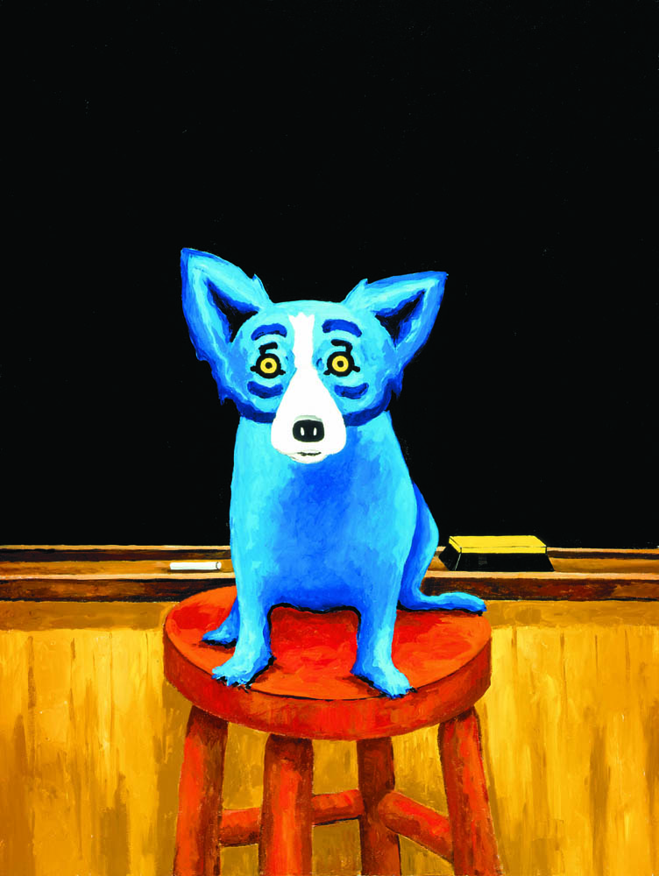
A Smarter Breed, 48x36 inches, acrylic on canvas, 2000

Slide 14
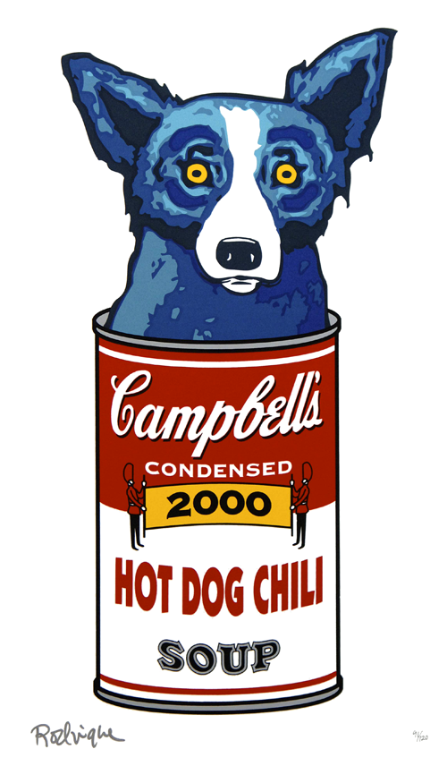
Hot Dog Chili, 32x18 inches, silkscreen, 2000

Slide 15
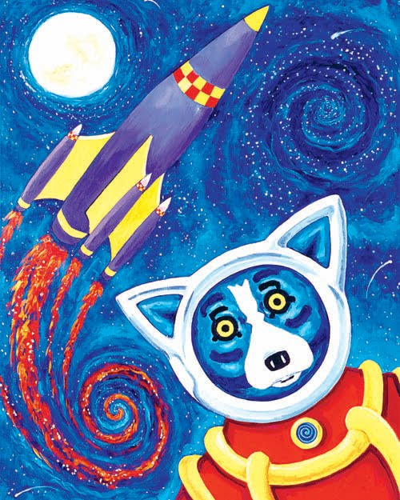
Life’s A Blast, acrylic on canvas, 2000

Slide 16
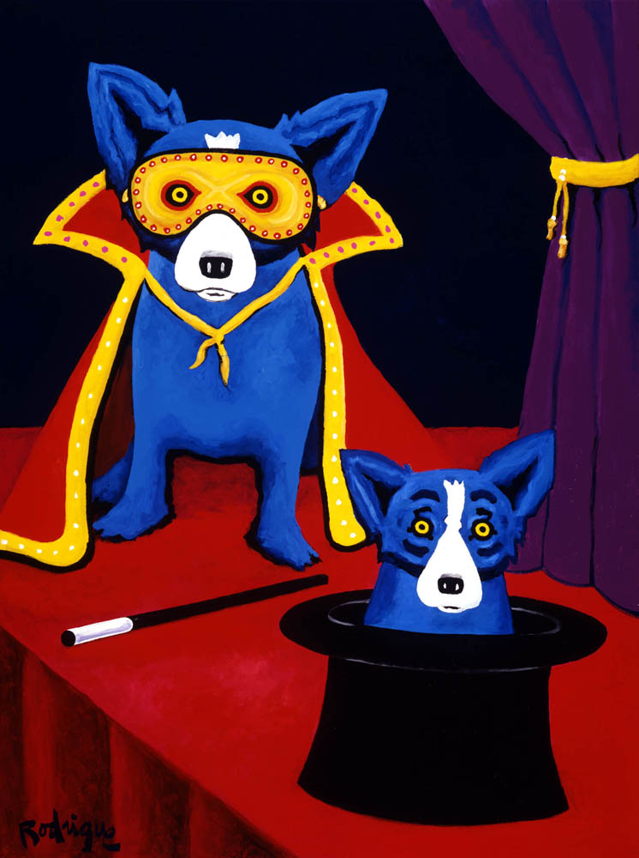
Now You See It, Now You Don’t, 48x36 inches, acrylic on canvas, 2000

Slide 17
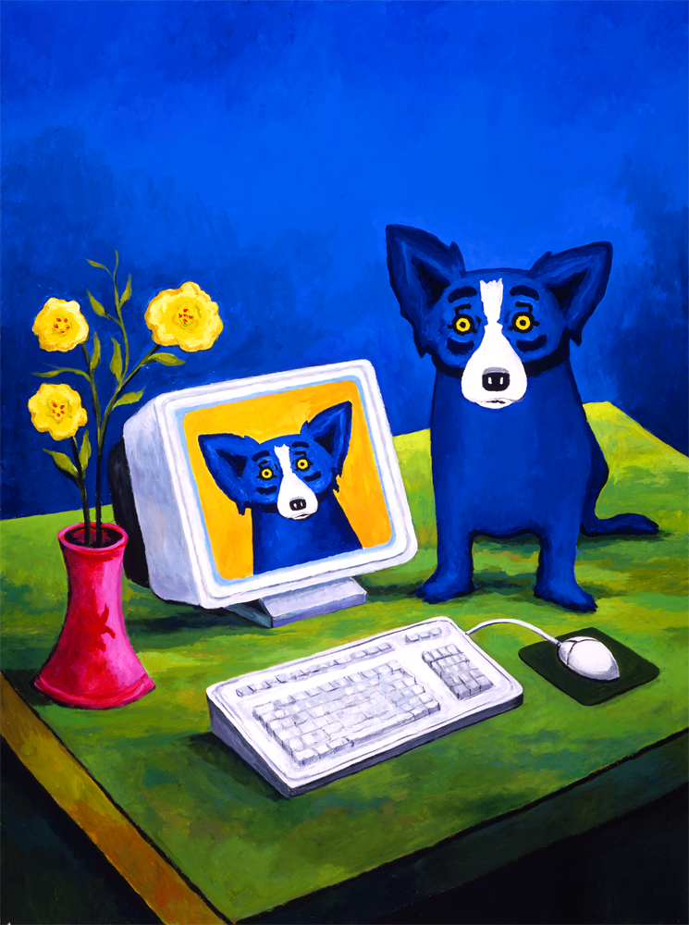
PC Blues, 48x36 inches, acrylic on canvas, 2000

Slide 18
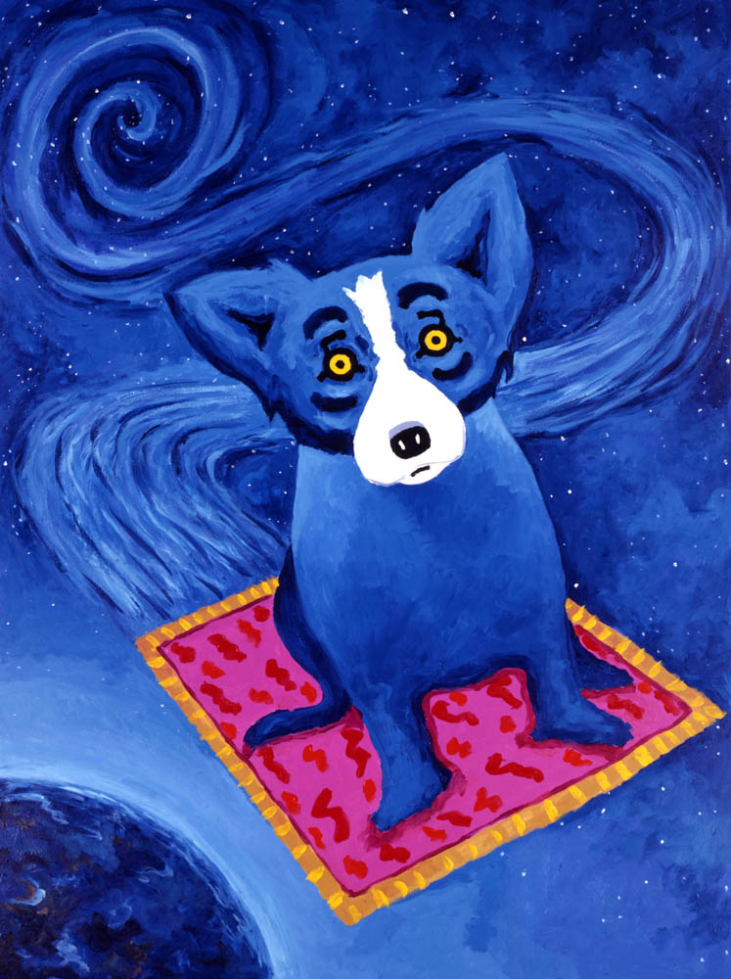
Star Hopping, acrylic on canvas, 2000

Slide 19
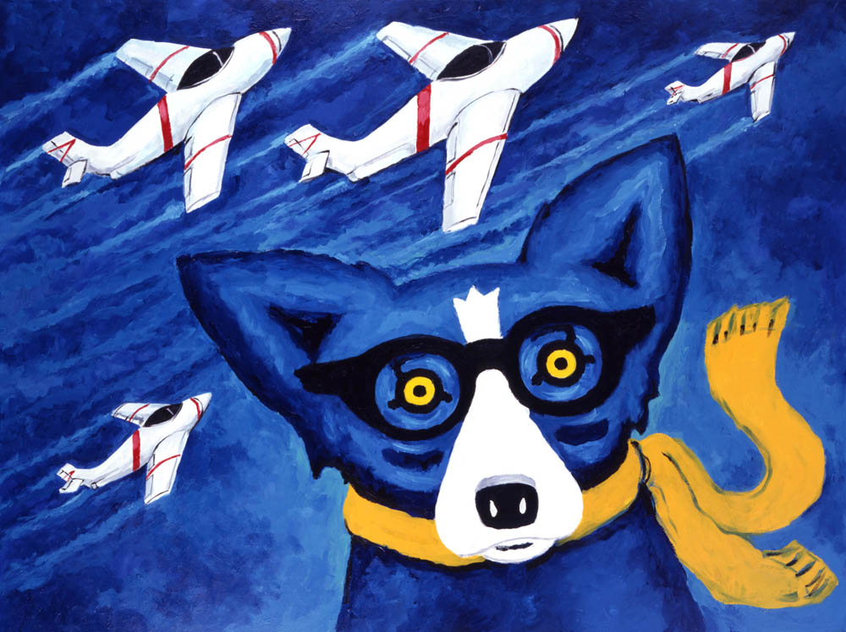
The Wild Blue Yonder, 36x48 inches, acrylic on canvas, 2000

Slide 20
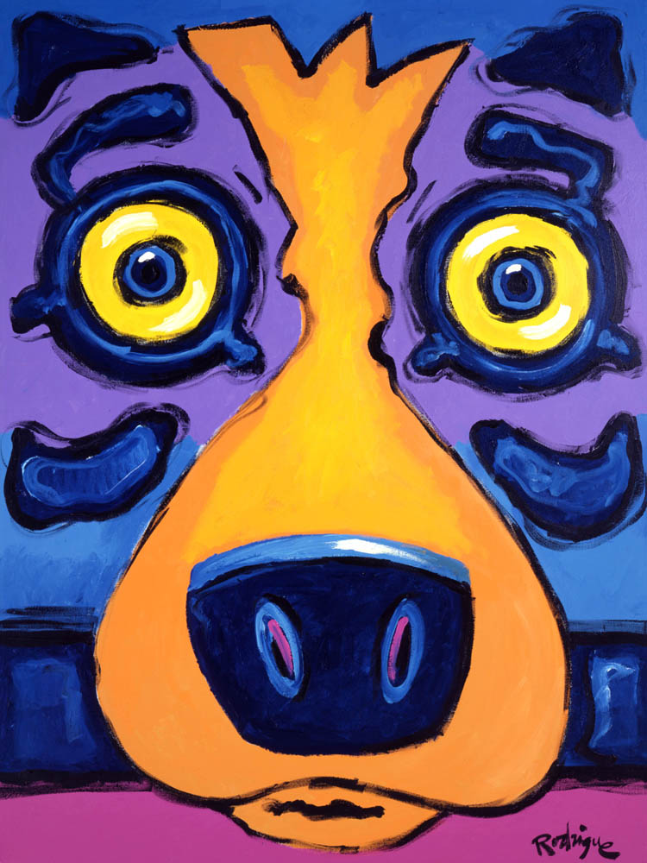
I Look Different Close Up, 40x30 inches, acrylic on canvas, 2001

Slide 21
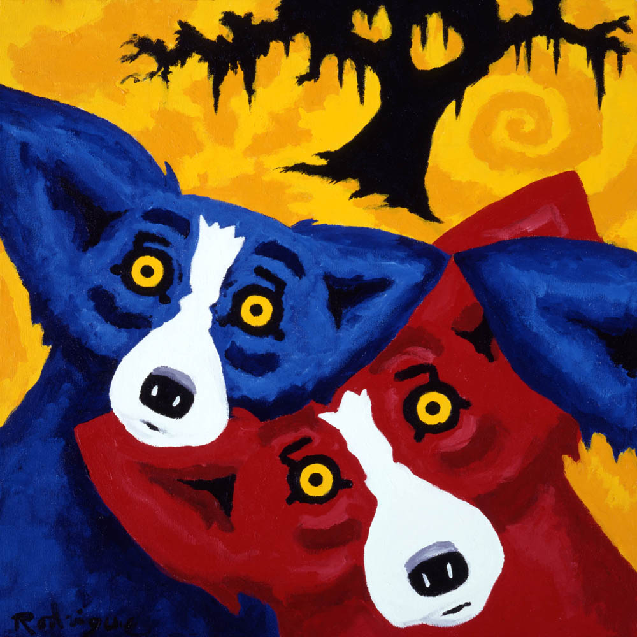
Evermore, 24x24 inches, acrylic on canvas, 2002

Slide 22
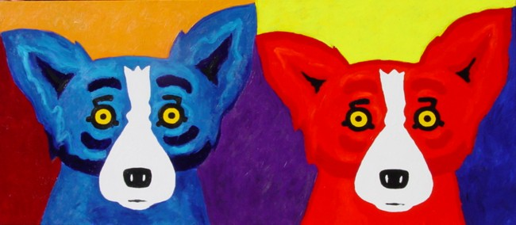
View of Hues, 36x40 inches, acrylic on canvas, 2002

Slide 23
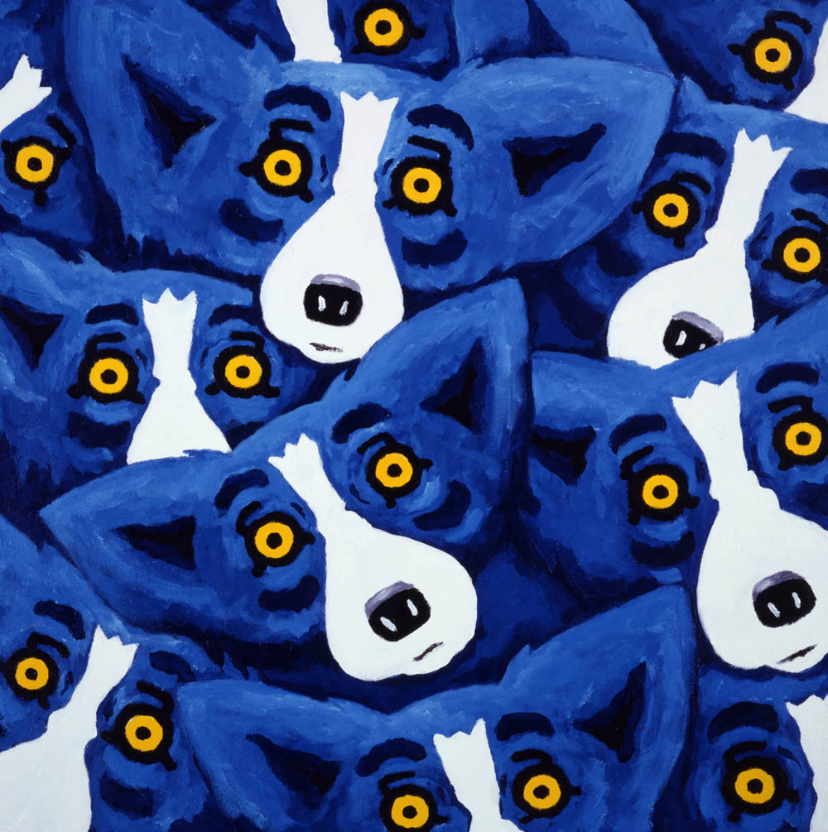
Everywhere, 30x30 inches, acrylic on canvas, 2003

Slide 24
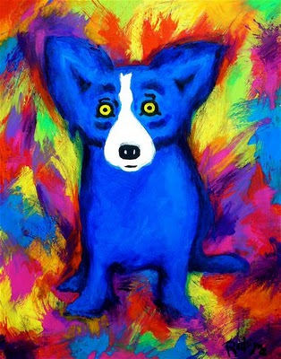
I Am an Artist, acrylic on canvas, 2006

Slide 25
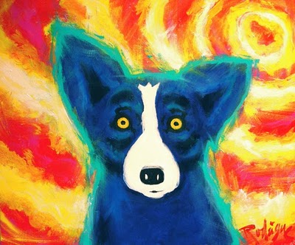
The Summer of ’06, acrylic on canvas, 2006

Slide 26
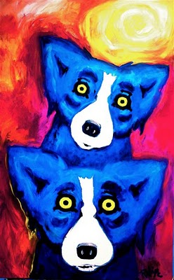
You’re the Only One Under the Sun, acrylic on canvas, 2006

Slide 27
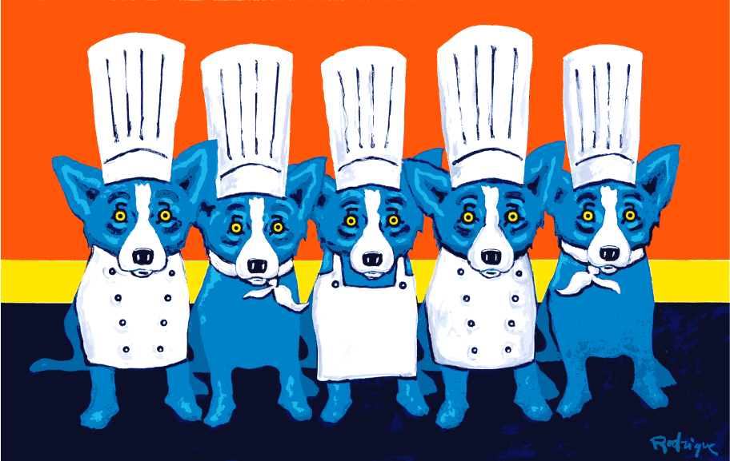
Heat in the Kitchen, 25x38 inches, silkscreen, 2009

Slide 28
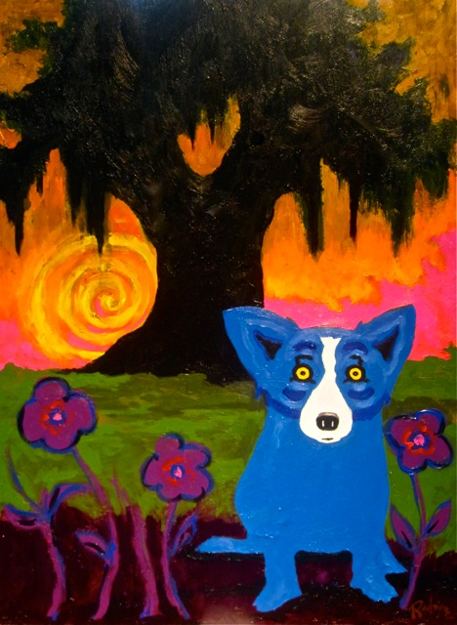
Colors in My Life, 24x18 inches, acrylic on canvas board, 2010

Slide 29
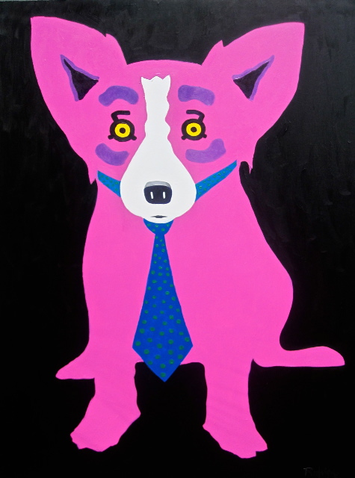
Cool Cat Dog, 48x36 inches, acrylic on canvas, 2010

Slide 30
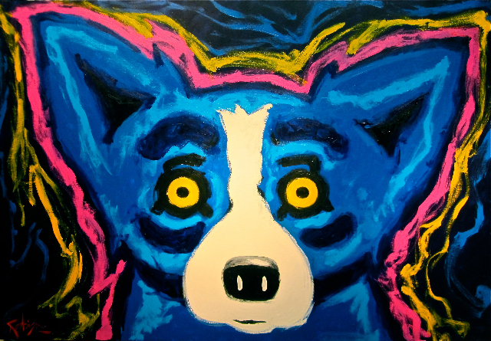
Headlights, 40x60 inches, acrylic on canvas, 2010

Slide 31
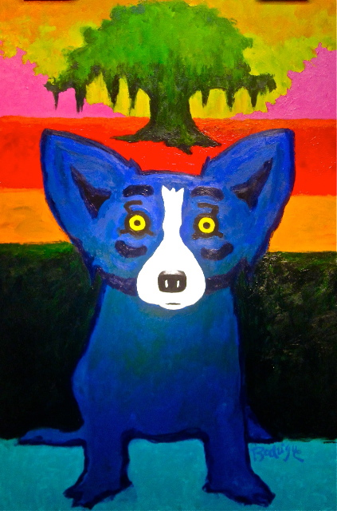
Looking Back at My Family Tree, 60x40 inches, acrylic on linen, 2010

Slide 32
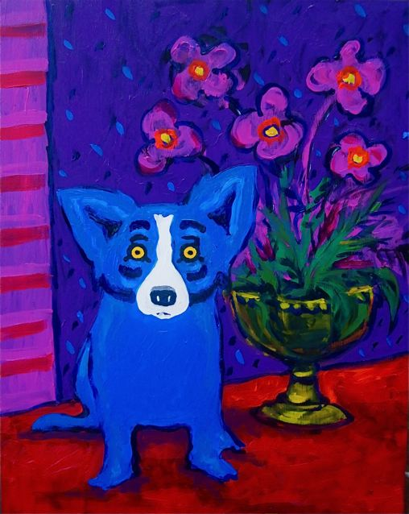
My Tea is Ready, 20x16 inches, acrylic on canvas panel, 2010

